Slide 1

Type 2 Diabetes
Risk Factor Analysis
Maggy Foote, Tim Mandel, Austin Vasquez

Slide 2
01
Objectives
of the project

Slide 3


Determine the correlation between health risk factors and Type 2 Diabetes
Delve further into risk factors with the highest correlation to determine how they interact with other risk factors

Slide 4
02
About the dataset

Slide 5
Self reported data collected via phone survey called the Behavioral Risk Factor Surveillance System conducted by the CDC
Collected in 2015
Contains information on 22 risk factors with 70,691 entries
Data source found here.

Slide 6
Most data is stored as a binary value (1 for yes, 0 for no)
All other data is categorical, with the exception of BMI
Data set consists of 50% diagnosed diabetics
and 50% non-diabetics, 35,346 total entries per category

Slide 7
03
General Demographics

Slide 8
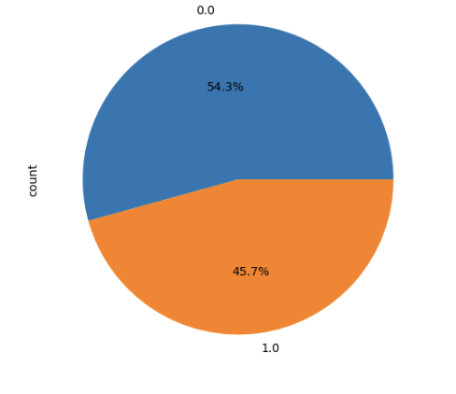
Sex
0: Male
1: Female

Slide 9
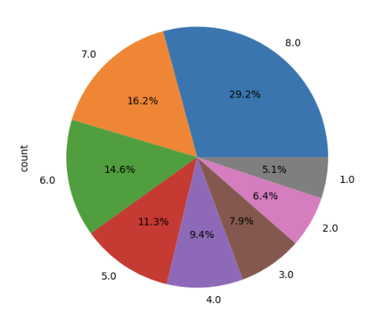
Income Levels
Less than $10,000
$10,000 to less than $15,000
$15,000 to less than $20,000
$20,000 to less than $25,000
$25,000 to less than $35,000
$35,000 to less than $50,000
$50,000 to less than $75,000
$75,000 or more

Slide 10
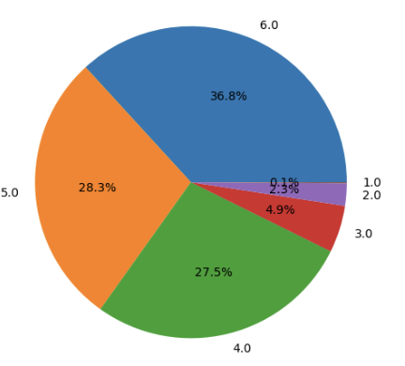
Education Levels
Never attended school or only kindergarten
Grades 1- 8 (Elementary)
Grades 9-11 (Some high school)
Grade 12 or GED (High school graduate
College 1 year to 3 years (Some college)
College graduate or higher

Slide 11
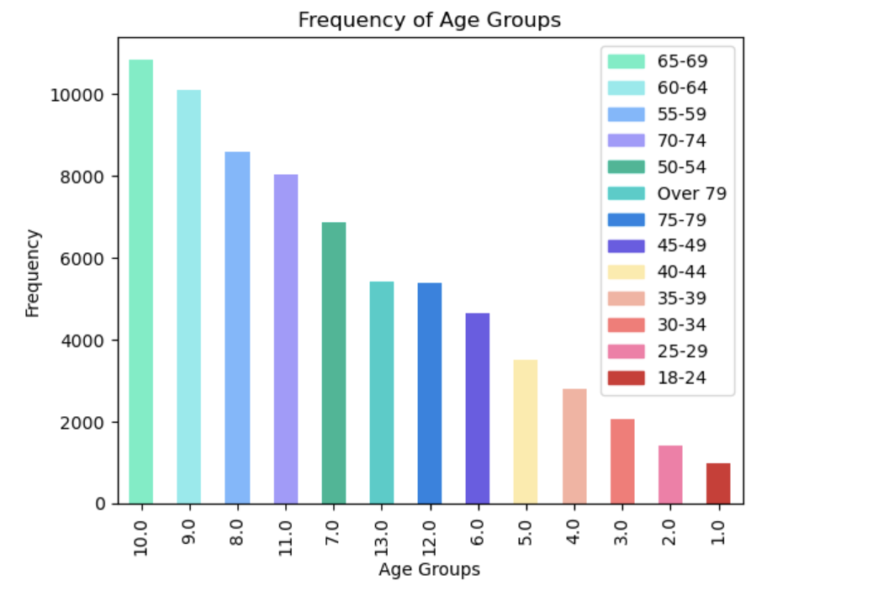
Age Range

Slide 12
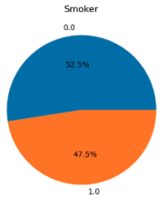
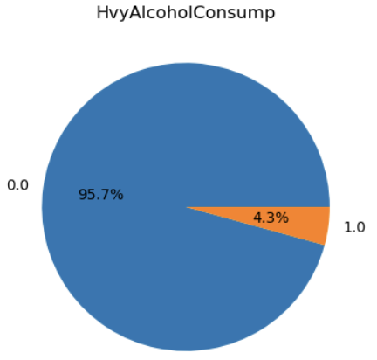
Lifestyle Choices

Slide 13
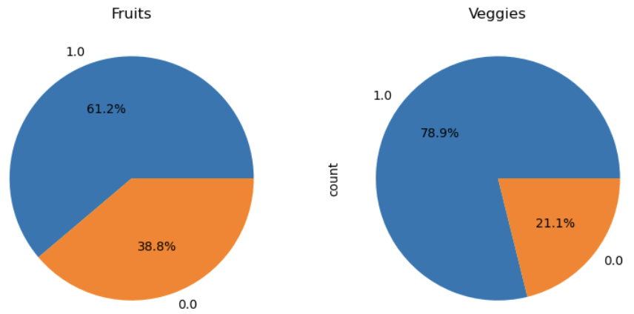
Lifestyle Choices

Slide 14
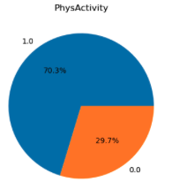
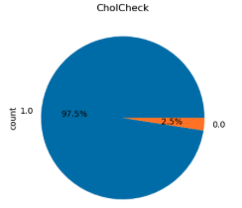
Lifestyle Choices

Slide 15
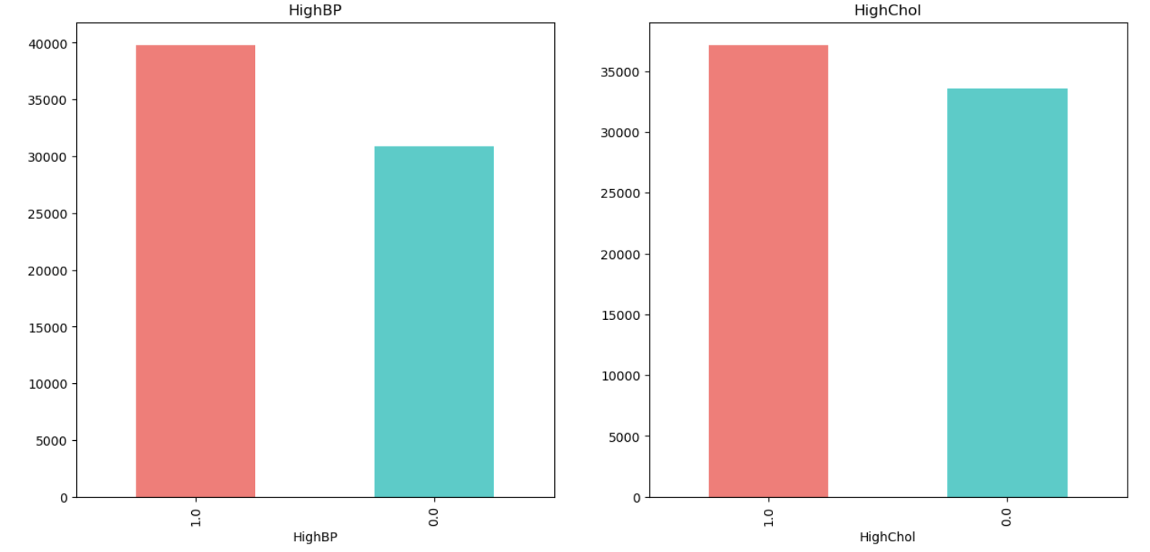
Risk Factors

Slide 16
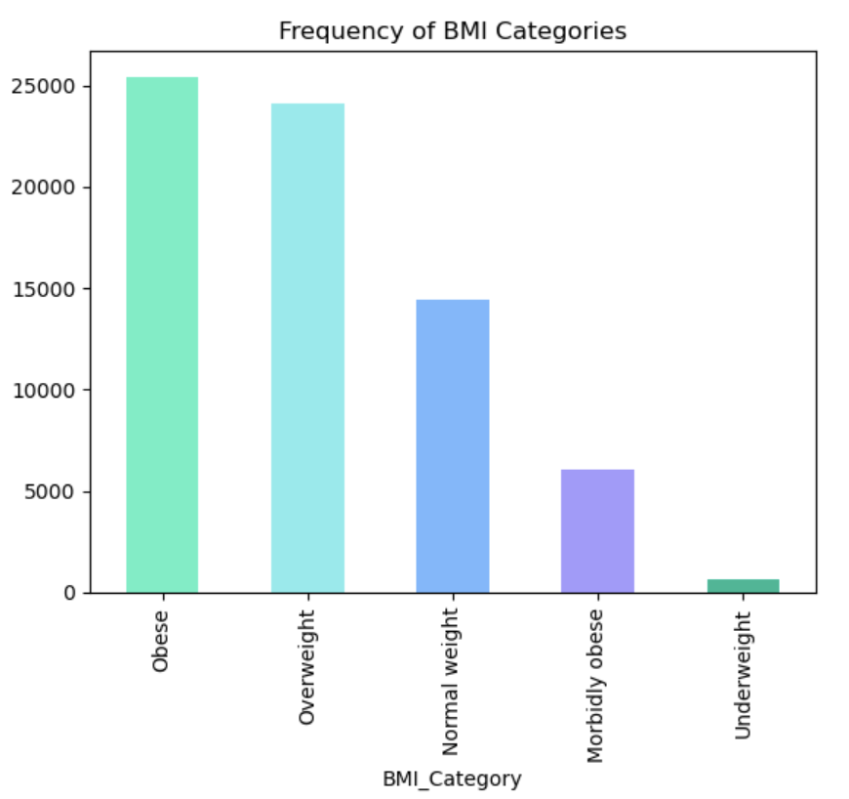
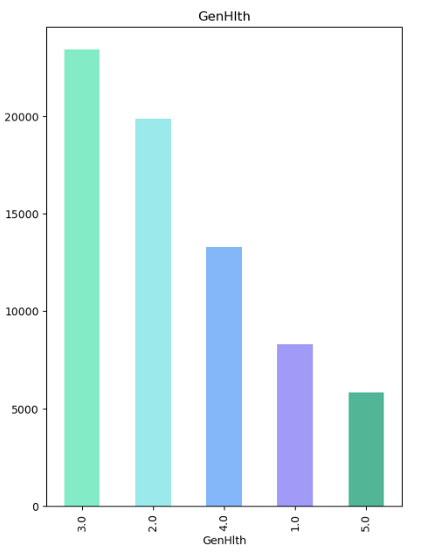
Risk Factors:

Slide 17
04
Exploratory Analysis

Slide 18
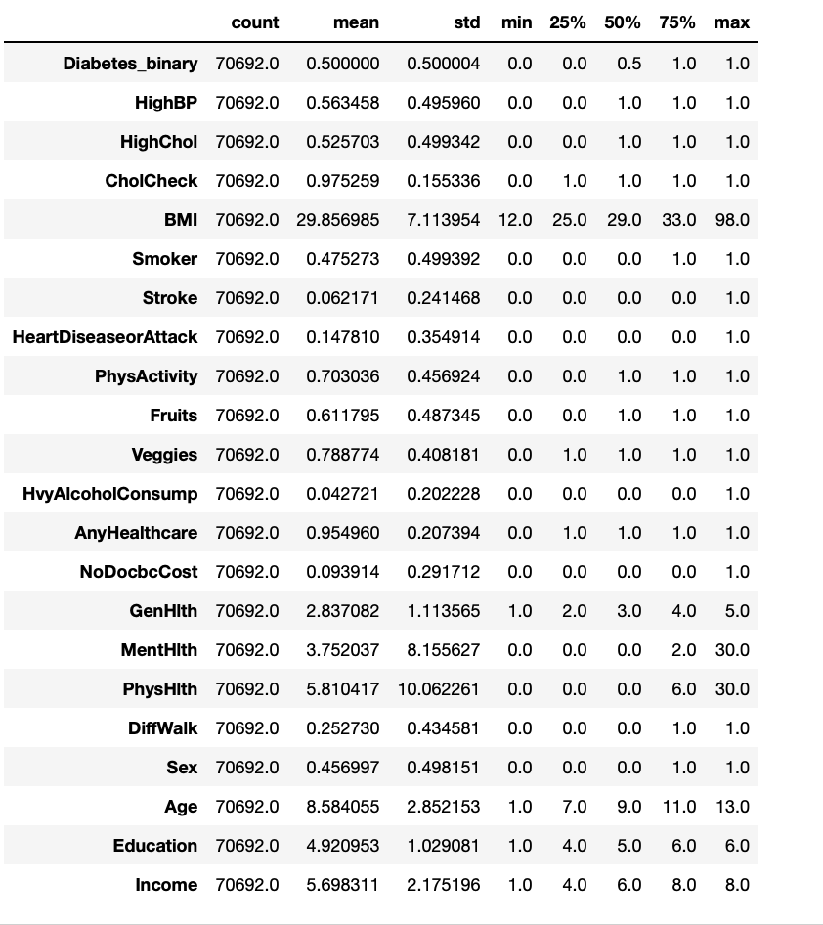
Basic
Description

Slide 19
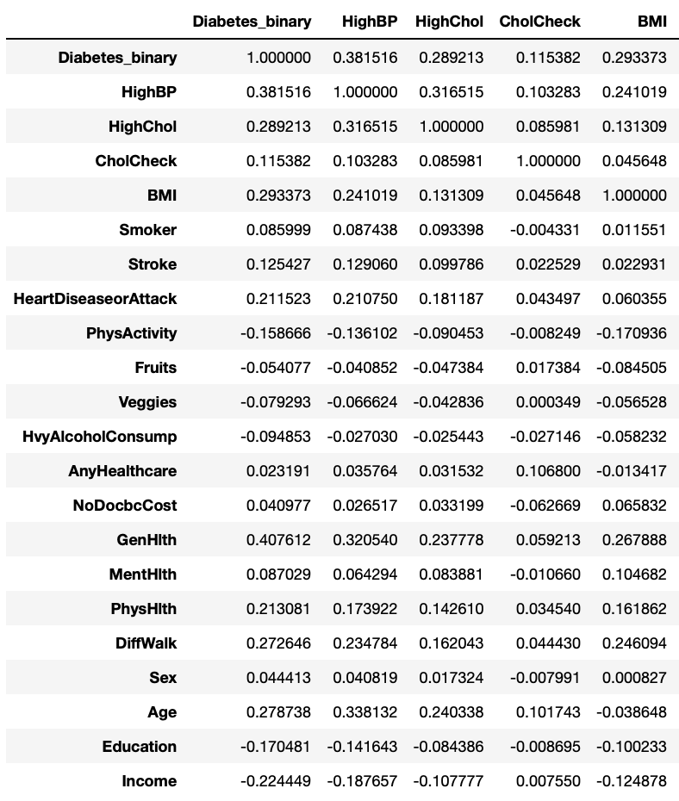
Numeric Correlation

Slide 20
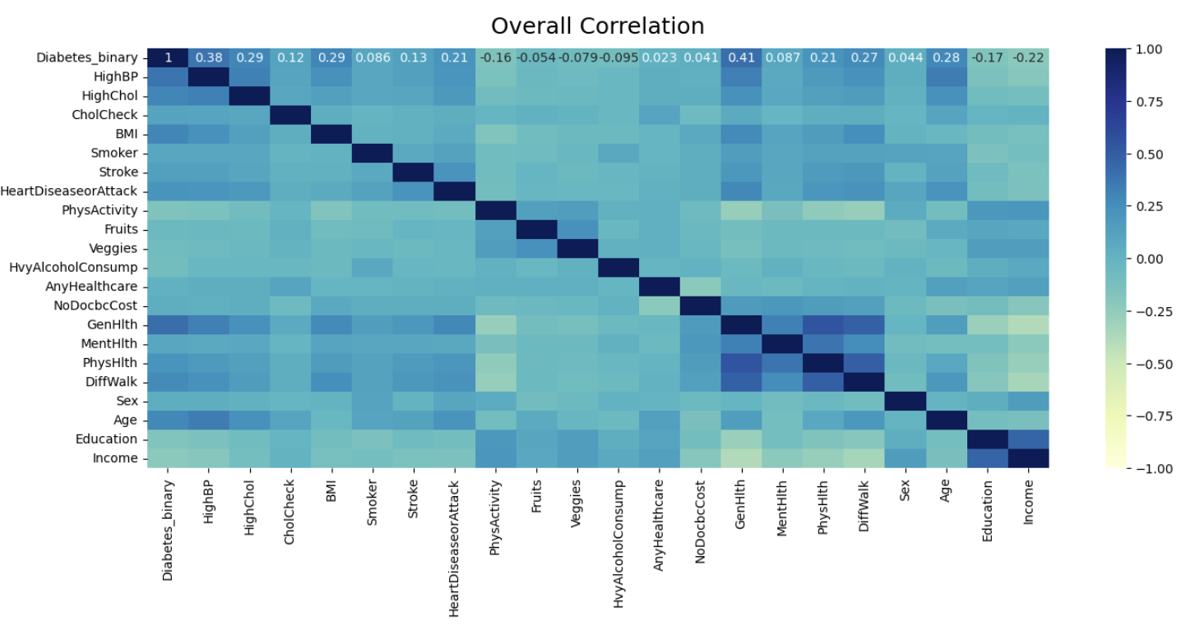
Correlation Heat Map

Slide 21
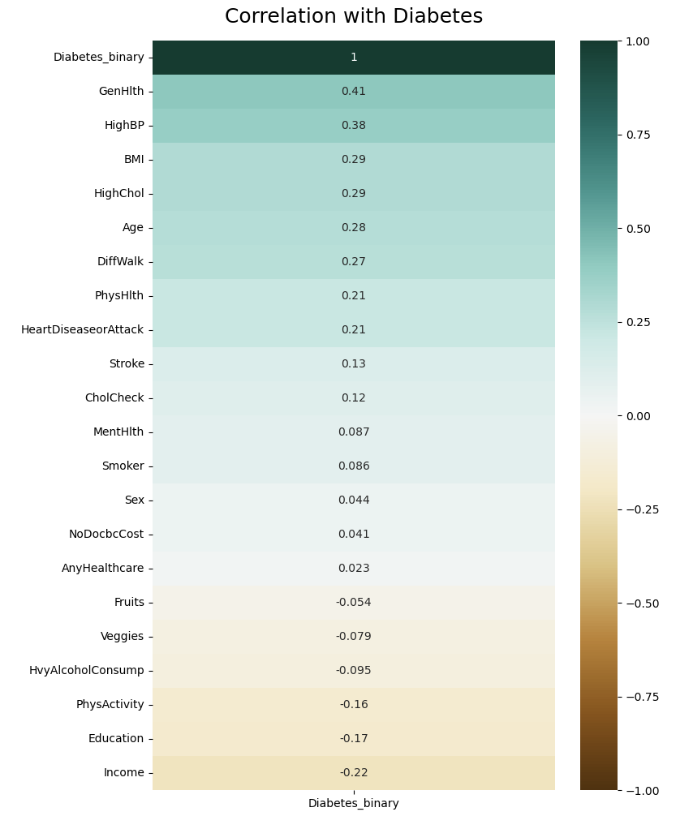
Single Correlation Heat Map

Slide 22
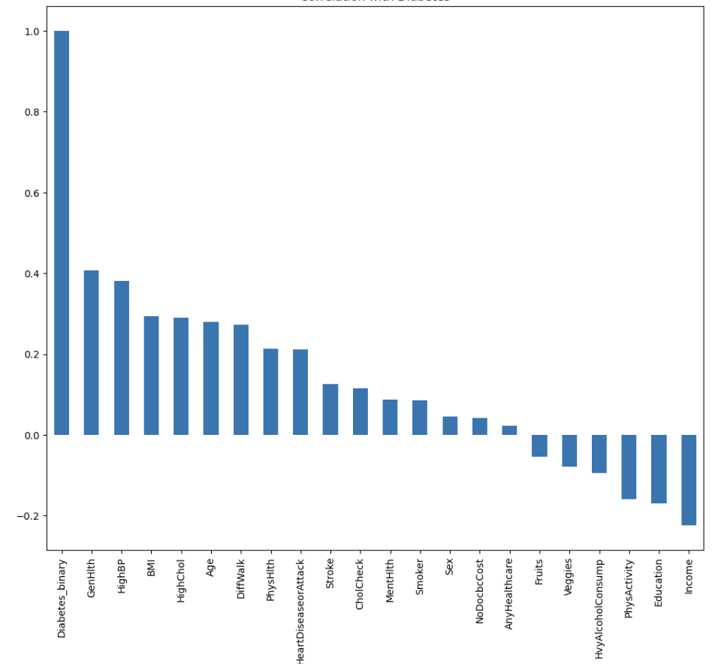
Alternative Visualization

Slide 23
Interesting
Code

Slide 24
Seaborn

Slide 25
01
Correlation
Deep-Dive

Slide 26
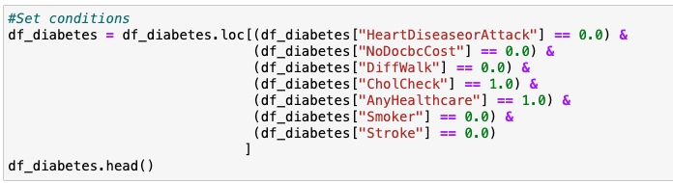
Mitigating Factors

Slide 27
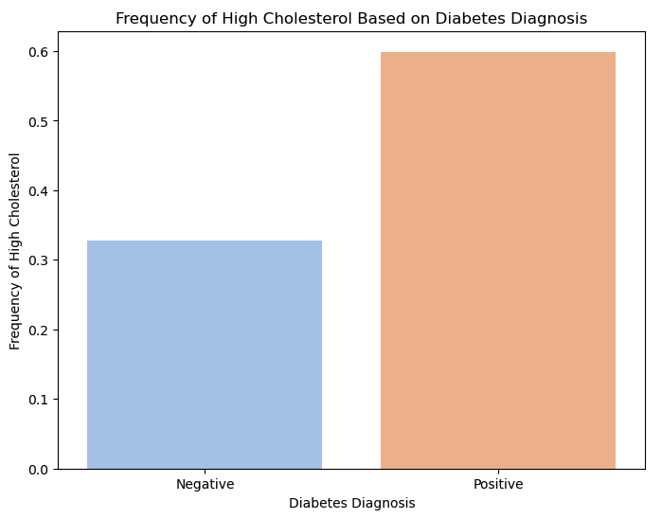
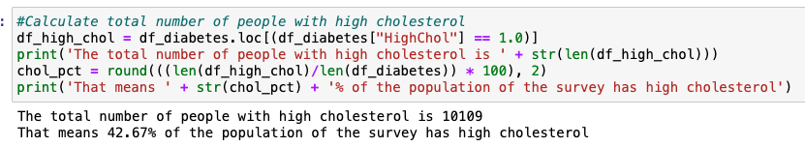
High Cholesterol in Relation to Diabetes

Slide 28
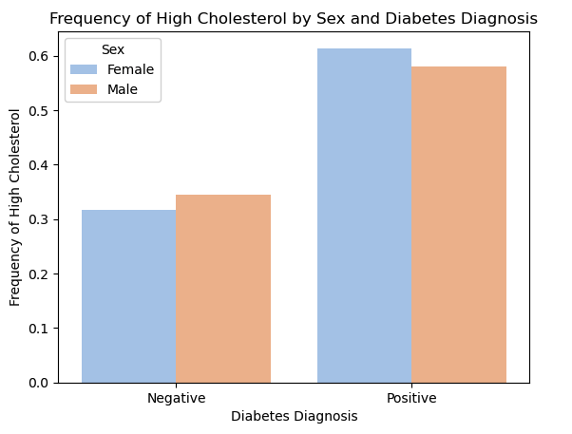
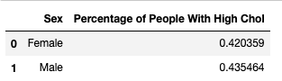
HC in Relation to Diabetes by Sex

Slide 29
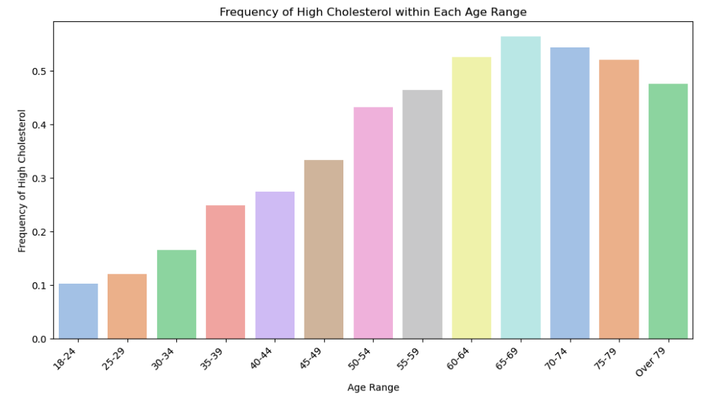
High Cholesterol by Age

Slide 30
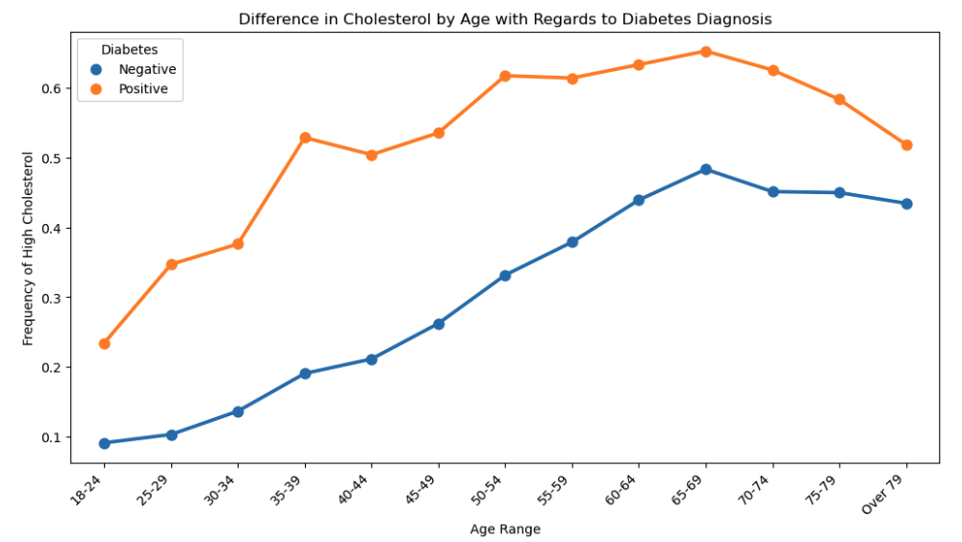
HC in Relation to Diabetes by Age

Slide 31
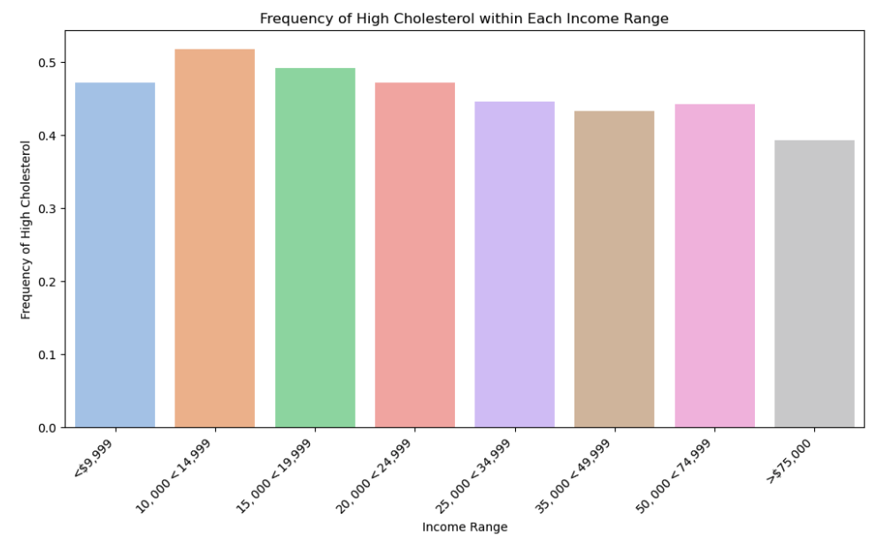
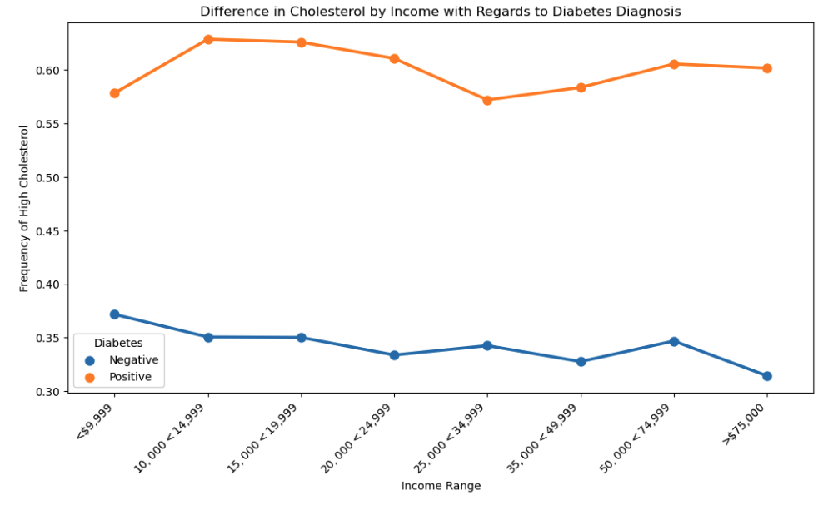
HC in Relation to Diabetes by Income

Slide 32
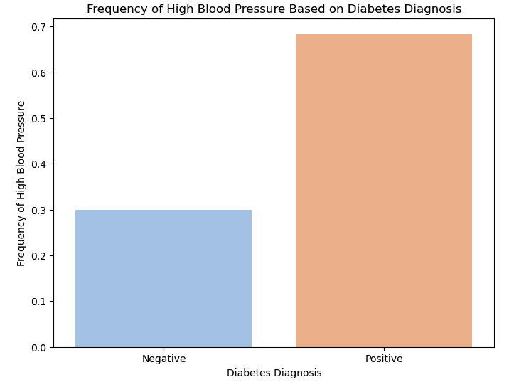

High Blood Pressure in Relation to Diabetes

Slide 33
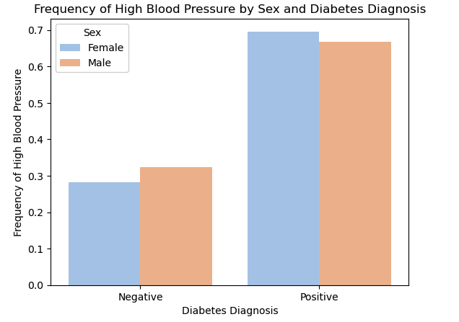
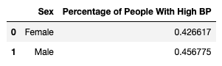
High BP in Relation to Diabetes By Sex

Slide 34
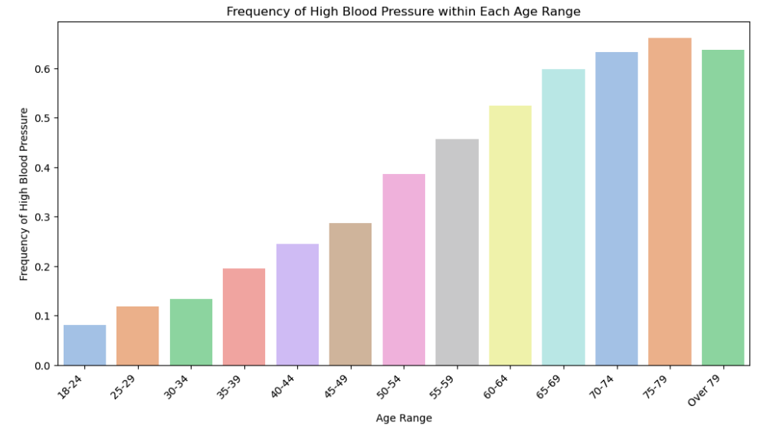
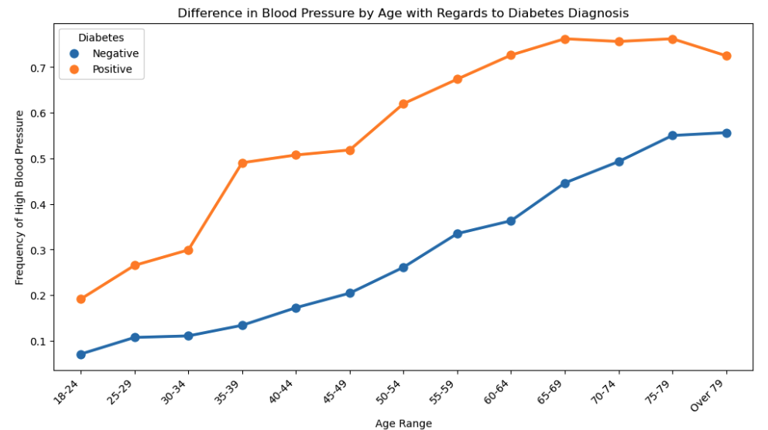
High BP in Relation to Diabetes by Age

Slide 35
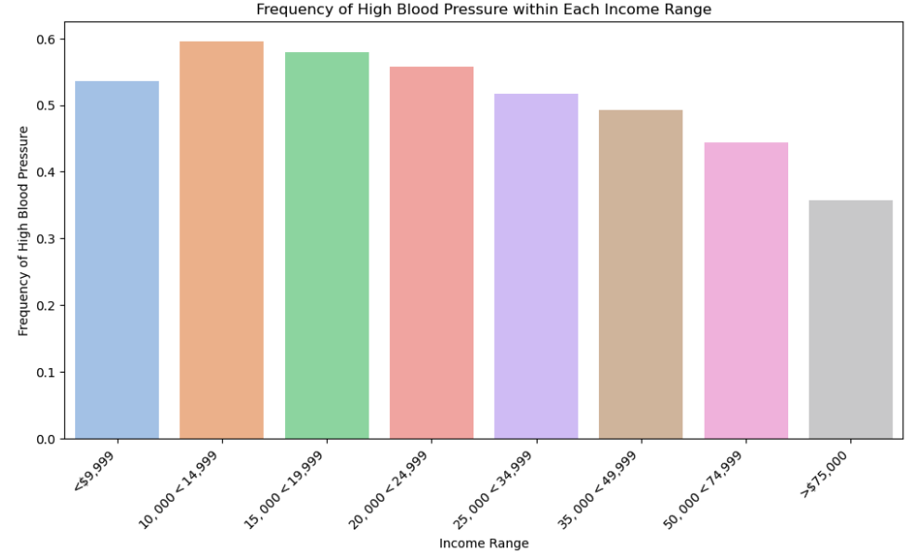
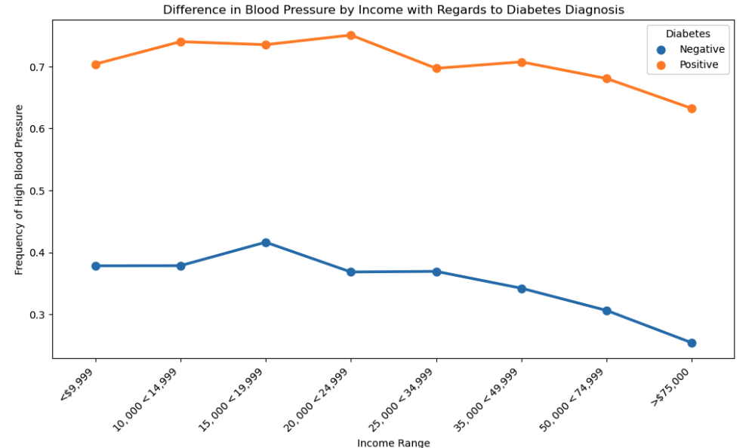
High BP in Relation to Diabetes by Income

Slide 36
Conclusions
High Cholesterol and High Blood Pressure are both significant factors in diabetes diagnoses
Both factors are remarkably similar when compared to other extraneous factors
Both factors worsen with age
Both factors are not greatly impacted by income

Slide 37
02
Correlation
Deep-Dive

Slide 38
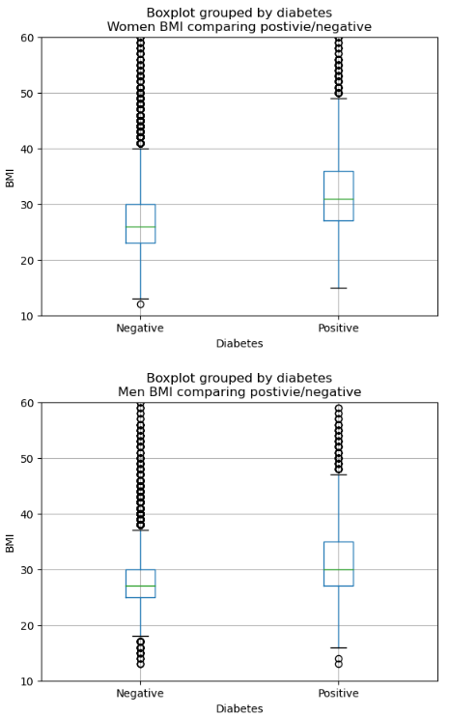
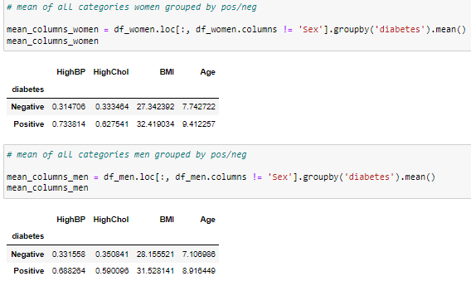

Slide 39
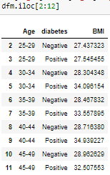
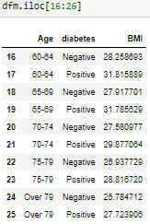
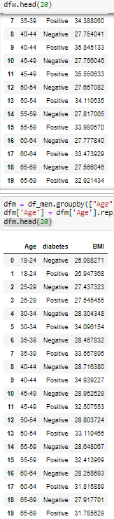
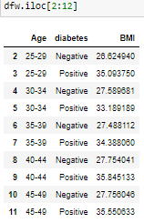
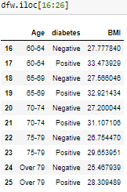
BMI with Age and Sex

Slide 40
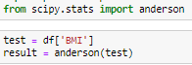
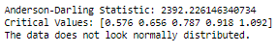
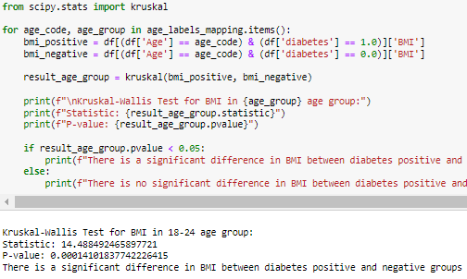
Stats of the stats
The Anderson-Darling test is used to assess whether a sample from a particular distribution follow a normal distribution. It is particularly useful when dealing with non-parametric data. BMI would be considered non-parametric in nature due to its large number of outliers.
Kruskal-Wallis test helps determine whether there are statistically significant differences in the central tendency of the continuous variable(BMI) across age groups.
This test is suitable because:
Non-parametric Nature: not normally distributed
Ordinal Data: continuous data (BMI)
3 or more Independent Groups: the age groups

Slide 41
Conclusions
BMI related to Age and Sex are great predictors on an individual’s likelihood of being diabetes positive or negative.
Helpful considering BMI in itself is a limited factor [Height x Weight]
Factors worsen with age as well
Women generally have higher variability with parameters. How significant these differences are would require a further dive

Slide 42
Interesting
Code

Slide 43
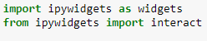
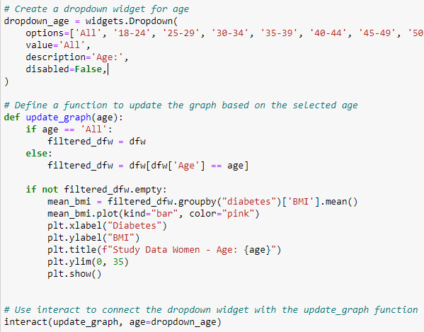
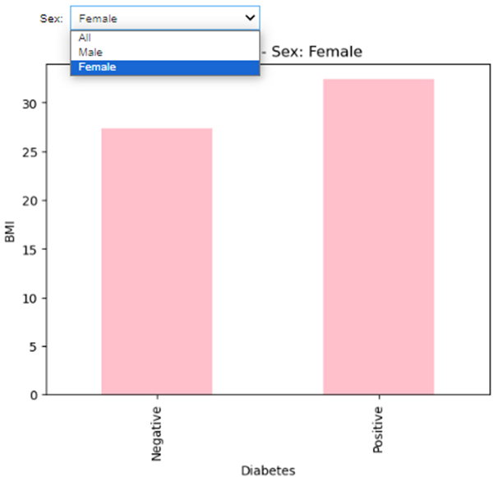
iPy Widgets
Widget

Slide 44
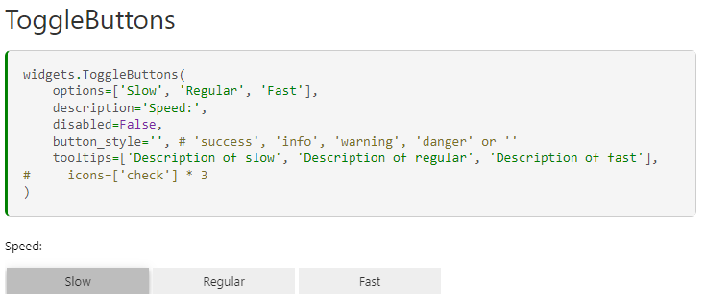
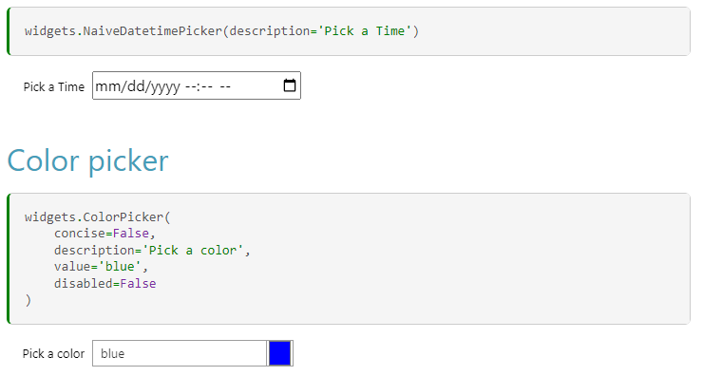
iPy Widgets
https://ipywidgets.readthedocs.io/en/stable/examples/Widget%20List.html

